Slide 1
WEEKLY STUDY MATERIAL
BA (Prog) III year
SEC- Creative Writing
Dept of English
Class Representative- Uday (7987469742)

Slide 2
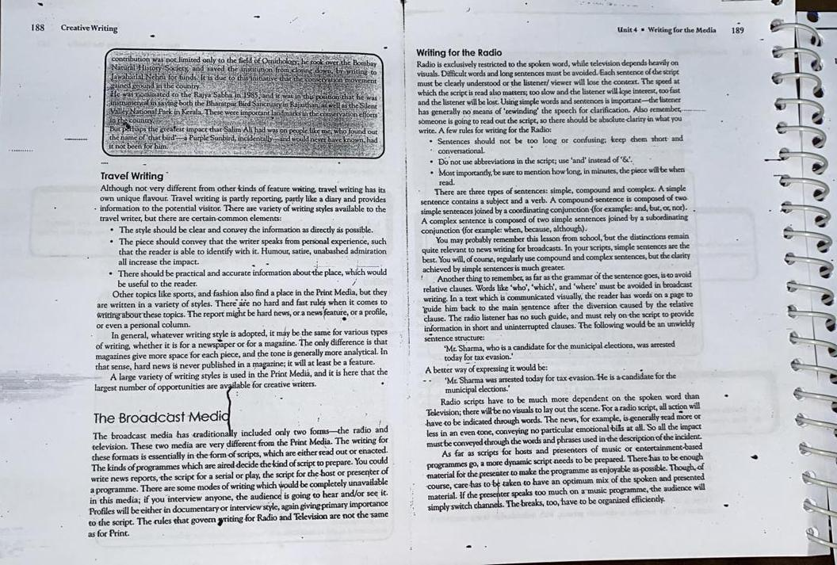

Slide 3

Illustration of Travel Writing

Slide 4
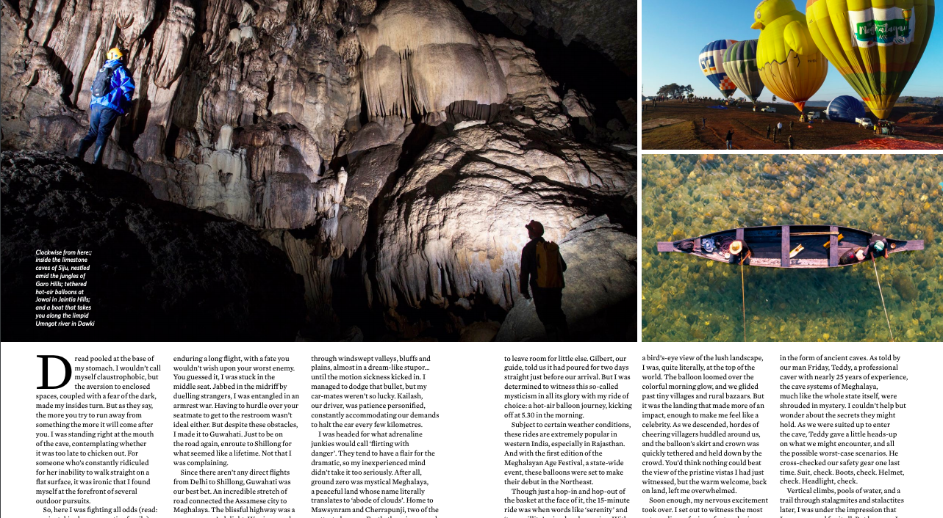
Source:
https://www.outlookindia.com/outlooktraveller/images/pdf/olt_april_2020.pdf

