Slide 1
MICROSOFT POWERPOINT
Graphics in Powerpoint
21-march-2020

Slide 2
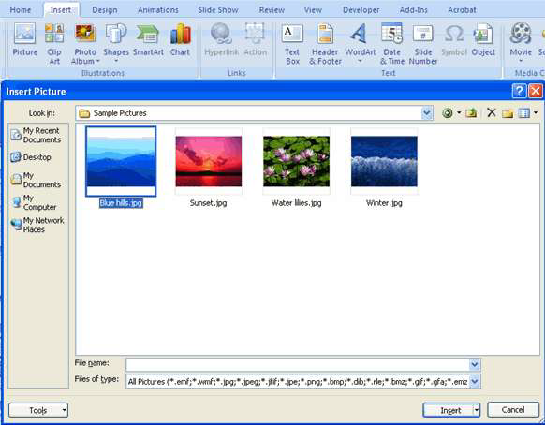
Adding Picture
To add a picture:
 Click the Insert Tab
 Click the Picture Button
 Browse to the picture from your files
 Click the name of the picture
 Click insert
 To move the graphic, click it and
drag it to where you want it

Slide 3
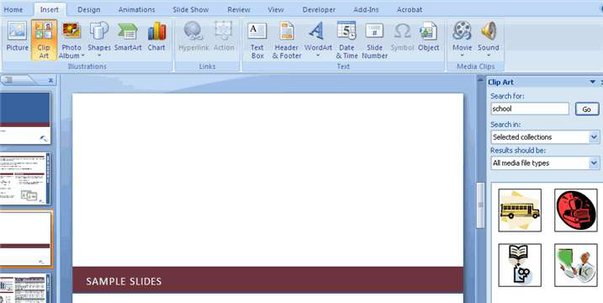
Adding Clip Art
To add Clip Art:
• Click the Insert Tab
• Click the Clip Art Button
• Search for the clip art using the
search Clip Art dialog box
• Click the clip art
• To move the graphic, click it
and drag it to where you want it

Slide 4

Editing Pictures and Clip Art
When you add a graphic to the presentation, an additional Tab appears on the Ribbon. The Format Tab allows you to format the pictures and graphics. This tab has four groups:
 Adjust: Controls the picture brightness, contrast, and colors
 Picture Style: Allows you to place a frame or border around the picture and add effects
 Arrange: Controls the alignment and rotation of the picture
 Size: Cropping and size of graphic

Slide 5
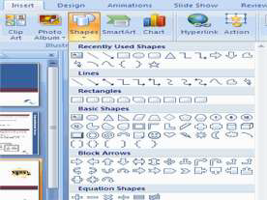
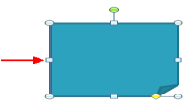
Adding a Shape
To add Shapes:
 Click the Insert Tab
 Click the Shapes Button
 Click the shape you choose
 Click the Slide
 Drag the cursor to expand the Shape

Slide 6
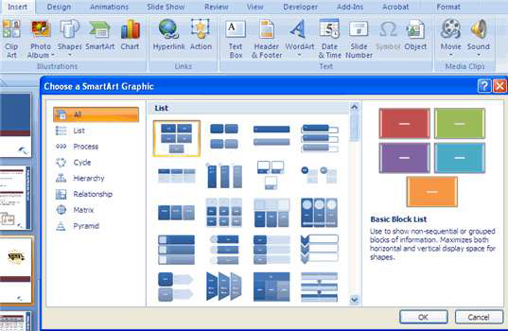
Adding SmartArt
SmartArt is a feature in Office 2007 that allows you to choose from a variety of graphics, including flow charts, lists, cycles, and processes.
To add SmartArt:
○ Click the Insert Tab
○ Click the SmartArt Button
○ Click the SmartArt you choose
○ Click the SmartArt
○ Drag it to the desired location in the slide

Slide 7

To format the SmartArt:
 Click the SmartArt
 Click either the Design or the Format tab
 Click the SmartArt to add text and pictures.

Slide 8
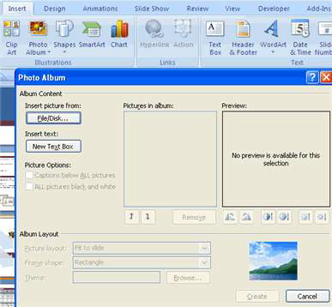
Adding a Photo Album
The photo album feature is new in PowerPoint 2007 and allows you to easily create a photo album to share pictures.
To create a photo album:
 Click the Photo Album button on the Insert tab
 Click New Photo Album
 Click File/Disk to add pictures to the photo album
 Move the pictures up and down in the order of the album but clicking the up/down arrows

Slide 9
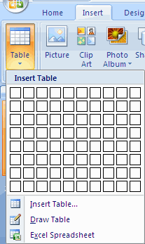
Tables:
Tables are used to display data in a table format.
Create a Table To create a table:
 Place the cursor on the page where you want the new table
 Click the Insert Tab of the Ribbon
 Click the Tables Button on the Tables Group.
You can create a table one of four ways:
➢ Highlight the number of row and columns
➢ Click Insert Table and enter the number of rows and columns
➢ Click the Draw Table, create your table by clicking and entering the rows and columns
➢ Click Excel Spreadsheet and enter data

Slide 10

Modify the Table Structure and Format a Table
To modify the structure of a table:
 Click the table and notice that you have two new tabs on the Ribbon: Design and Layout. These pertain to the table design and layout.
On the Design Tab, you can choose:
 Table Style Options
 Table Styles
 Draw Borders

Slide 11

To format a table, click the table and then click the Layout Tab on the Ribbon. This Layout tab allows you to:
 View Gridlines and Properties (from the Table Group)
 Insert Rows and Columns (from the Rows & Columns Group)
 Delete the Table, Rows and/or Columns (from the Rows & Columns Group)
 Merge or Split Cells (from the Merge Group)
 Increase and decrease cell size (Cell Size Group)
 Align text within the cells and change text directions (Alignment Group)

Slide 12
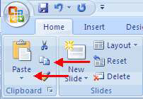
Insert a Table from Word or Excel
 Open the Word document or Excel worksheet
 Select the chart
 Click Copy on the Home tab
 Go to the PowerPoint document where you want the chart located
 Click Paste on the Home tab

Slide 13
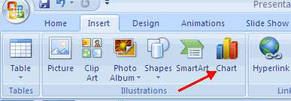
Charts allow you to present information contained in the worksheet in a graphic format. PowerPoint offers many types of charts including: Column, Line, Pie, Bar, Area, Scatter and more. To view the charts available click the Insert Tab on the Ribbon.
Create a Chart To create a chart:
➢Click the Insert tab on the ribbon
➢Click the type of Chart you want to create
➢Insert the Data and Labels

Slide 14
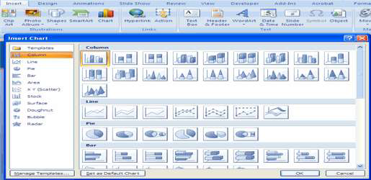
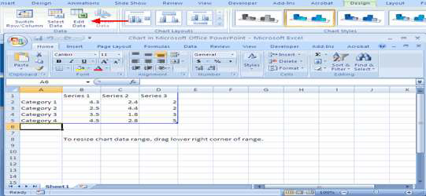
Edit Chart Data To edit chart data:
➢Click on the chart
➢Click Edit Data on the Design tab
➢Edit data in the spreadsheet

Slide 15
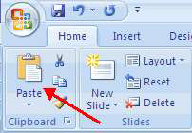
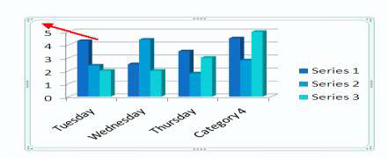
Modify a Chart
Once you have created a chart you can do several things to modify the chart. To move the chart:
 Click the Chart and Drag it another location on the same slide, or
 Copy it to another slide
 Choose the desired location and click Paste
To modify the chart size:
➢Click the Chart
➢Click on any of the corners and drop and drag to resize

Slide 16
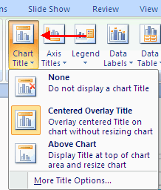
To modify the labels and titles:
 Click the chart
 Click the Layout tab
 Choose the appropriate label to change

Slide 17
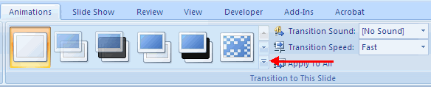
Slide Effects
Slide Transitions
Transitions are effects that are in place when you switch from one slide to the next. To add slide transitions:
➢ Select the slide that you want to transition
➢ Click the Animations tab
➢ Choose the appropriate animation or click the Transition dialog box.

Slide 18
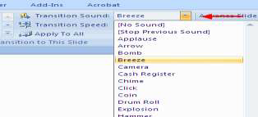
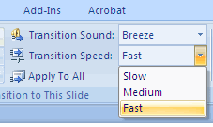
To adjust slide transitions:
▪ Add sound by clicking the arrow next to Transition Sound
▪Modify the transition speed by clicking the arrow next to Transition Speed

Slide 19
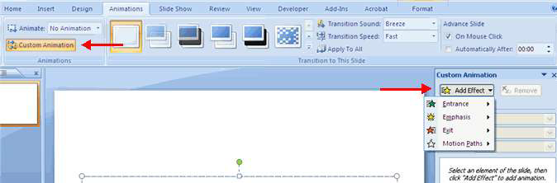
Slide Animation
Slide animation effects are predefined special effects that you can add to objects on a slide. To apply an animation effect:
 Select the object
 Click the Animations tab on the Ribbon
 Click Custom Animation
 Click Add Effect
 Choose the appropriate effect

Slide 20
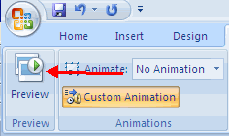
Animation Preview
To preview the animation on a slide:
 Click the Preview button on the Animations tab

Slide 21
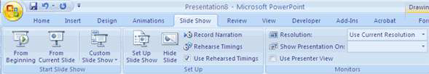
Slide Show Options
The Slide Show tab of the ribbon contains many options for the slide show. These options include:
 Preview the slide show from the beginning
 Preview the slide show from the current slide
 Set up Slide Show

Slide 22
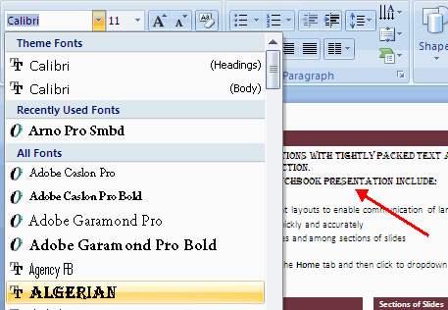
Formatting Text
Change Font Typeface and Size
To change the font typeface:
 Click the arrow next to the font name and choose a font.
 Remember that you can preview how the new font will look by highlighting the text, and hovering over the new font typeface.

Slide 23
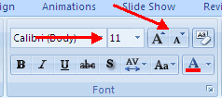

To change the font size:
 Click the arrow next to the font size and choose the appropriate size, or
 Click the increase or decrease font size buttons.
Font Styles and Effects
Font styles are predefined formatting options that are
used to emphasize text. They include: Bold, Italic,
and Underline. To add these to text:
➢Select the text and click the Font Styles included
on the Font group of the Home tab or
➢Select the text and right click to display the font tools

Slide 24
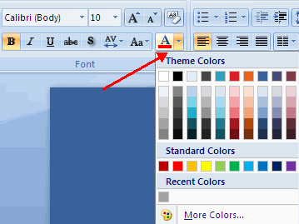
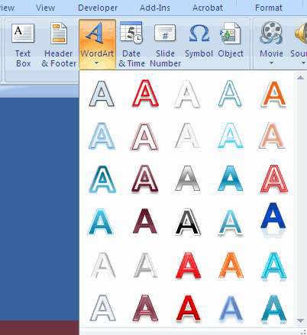
Change Text Color
To change the text color:
 Select the text and click the Colors button included on the Font Group of the Ribbon, or
 Highlight the text and right click and choose the colors tool.
 Select the color by clicking the down arrow next to the font color button. WordArt
WordArt are styles that can be applied to text to create a visual effect.
To apply WordArt:
 Select the text
 Click the Insert tab
 Click the WordArt button
 Choose the WordArt

Slide 25
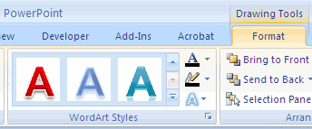
To modify the styles of WordArt
 Select the WordArt
 Click the Format tab for the Drawing Tools
 Click the WordArt Fill button, the WordArt Outline button, or the Text Effects button

Slide 26
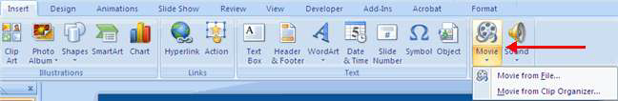
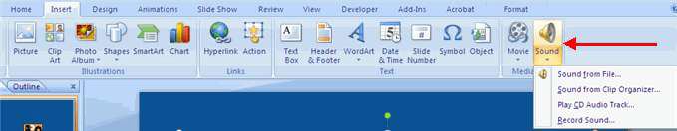
Adding Video
Video clips can be added to the presentation.
To add a video clip:
 Click the Movie button on the Insert tab
 Choose Movie from File or Movie from Clip Organizer
Adding Audio
Audio clips can be added to the presentation.
To add an audio clip:
•Click the Audio button on the Insert tab
•Choose Sound from File, Sound from Clip Organizer, Play CD Audio Track, or Record
Sound

Slide 27
Design Tips
 Slides should be of a consistent design throughout the presentation
 Use graphics and pictures when possible
 Remove unnecessary information and graphics
 Use contrasting background and text colors
 Keep the number of fonts used in the presentation to 3
 Keep the fonts consistent throughout the presentation

Slide 28
Presentation Tips
 Identify the critical information for your presentation
 Use no more than 6 bullets per page
 Bullets should be short ideas, not complete sentences (these should be your talking points)
 To start the Slide Show, Click Slide Show on the Presentation Views group on the View tab
 Use the arrow keys to move forward or backward in a presentation
 Press the Escape (Esc) key to end the slide show
 A pen tool is available for drawing on the screen with the mouse. Press CTRL+P or click the right mouse button at any time and a popup window will appear. Choose Pen and the pointer will change to a pen that allows you to draw freehand on the screen using the mouse. Press the E key to erase all pen strokes. Press CTRL+A to disable the pen
feature and revert the pen back to a pointer arrow.

