Slide 1
WEEKLY STUDY MATERIAL
English (Hons.) III year
Paper 8: Literature and Cinema
Unit 4: From Russia With Love
Class Representative- Vani (8433206814)

Slide 2
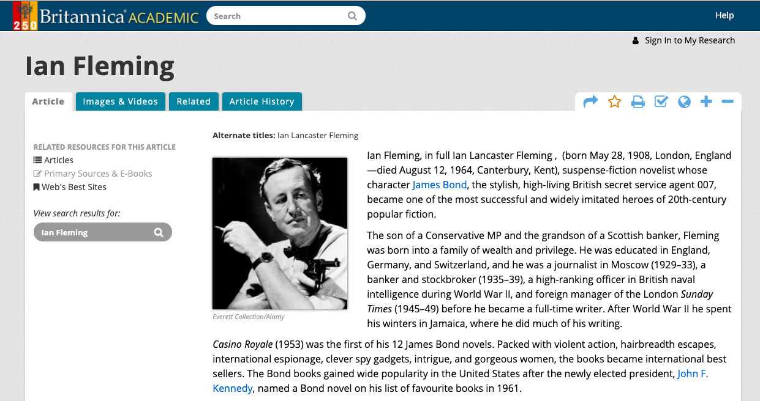
https://duelibrary.informaticsglobal.com:3088/levels/collegiate/article/Ian-Fleming/34539

Slide 3
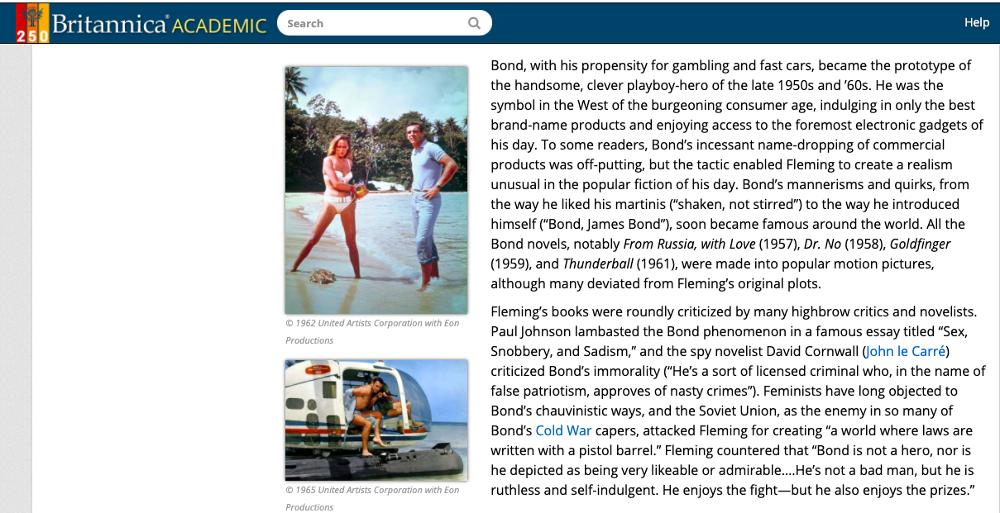

Slide 4
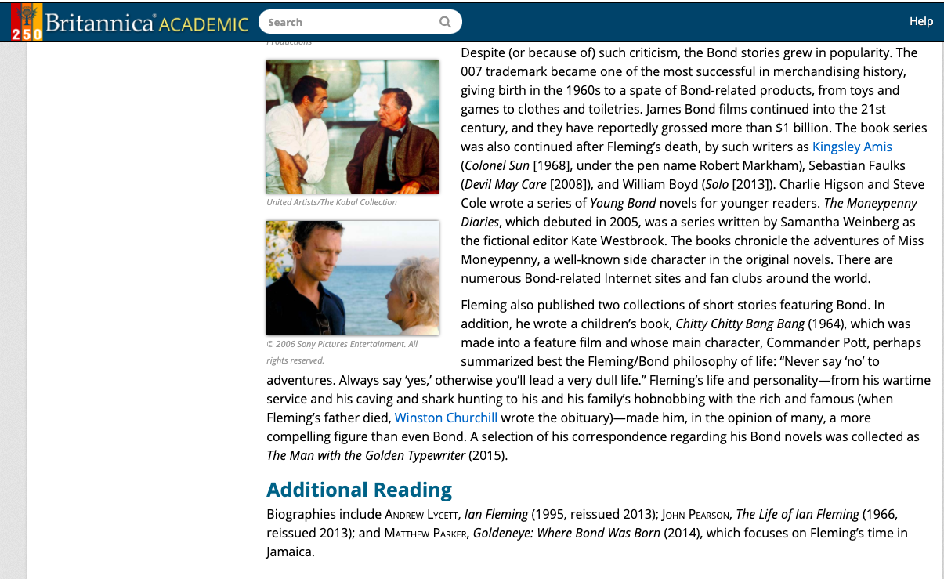

Slide 5
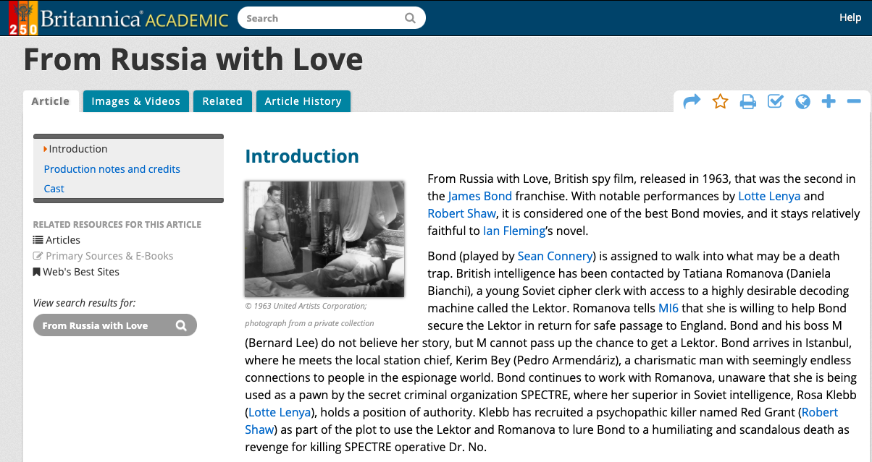

Slide 6
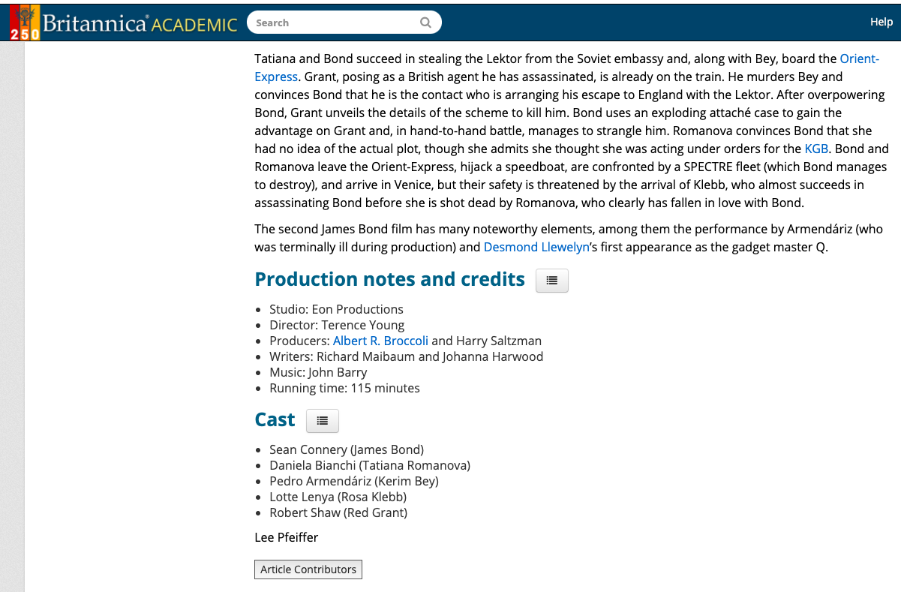

Slide 7
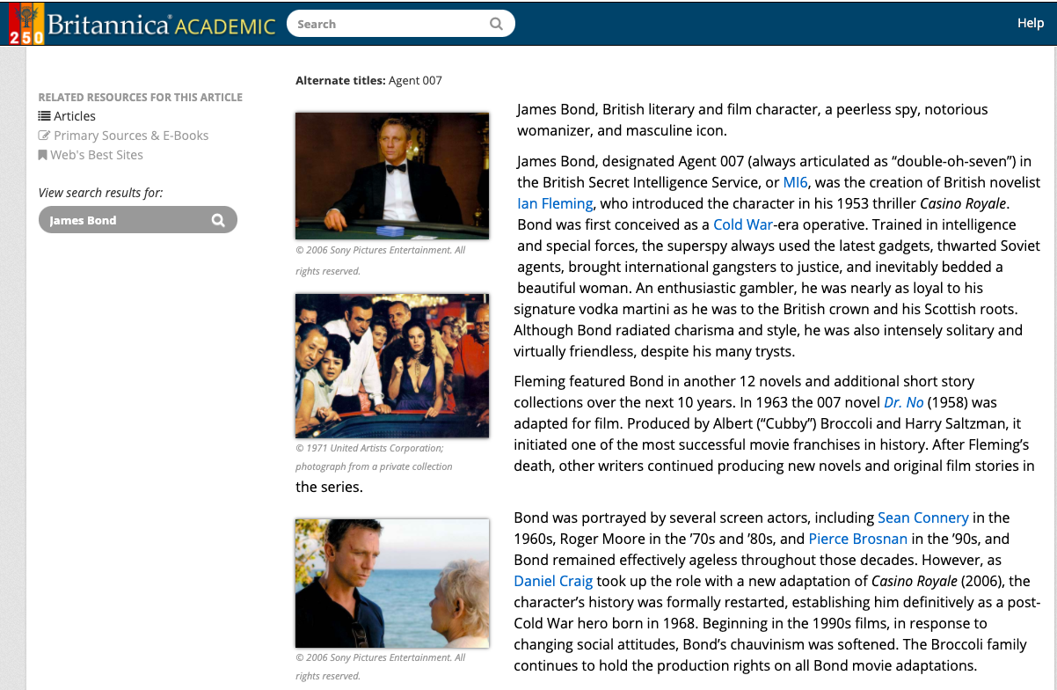

Slide 8


Slide 9
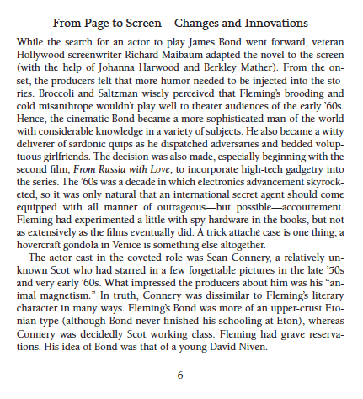

Slide 10
Also see: https://drive.google.com/file/d/1nHyRDtwwQNsVnH9A95YXWaQkYqECqGX4/view?usp=sharing

