Slide 1
Active filters 1st & 2nd order low pass and high pass filter

Slide 2
Active filters and oscillators
An electric filter is often a frequency selective circuit that passes a specified band of frequencies and block or attenuates signals of frequencies outside this band.
Classified of filters
Analog or digital
Passive or active
Audio and radio frequency

Slide 3
Active filters
As their name implies, Active Filters contain active components such as operational amplifiers, transistors or FET’s within their circuit design. They draw their power from an external power source and use it to boost or amplify the output signal.
These are generally used in communication and signal processing i.e. radio, television etc.
Advantage of Active filters over Passive filters
Gain and frequency adjustment flexibility
No loading problem (because of high i/p and low o/p resistance of op-amp)
Active filters are cheaper than passive filters

Slide 4
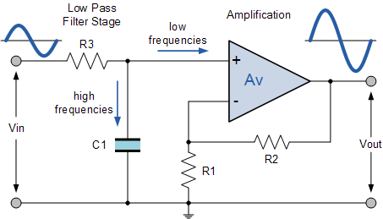
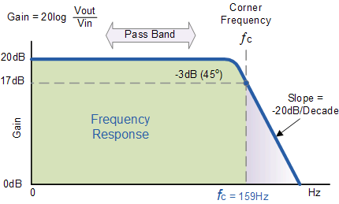
First order low pass filter
Fig.1 circuit diagram
Fig.2 Frequency response
Note : The op-Amp is used in the non- inverting configuration ; hence it does not load down the RC Network.

Slide 5
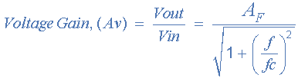



Gain of a first-order low pass filter
Where:
A_{F} = the pass band gain of the filter, (1 + R2/R1)
ƒ = the frequency of the input signal in Hertz, (Hz)
ƒc = the cut-off frequency in Hertz, (Hz)
Thus, the operation of a low pass active filter can be verified from the frequency gain equation above as:
1. At very low frequencies, ƒ < ƒc
2. At the cut-off frequency, ƒ = ƒc
3. At very high frequencies, ƒ > ƒc

Slide 6
Designing Low pass filter
Choose a value of high cut off Frequency ƒc
2. Select a value of C less than or equal to 1µF. Mylar or tantalum capacitor are recommended for better performance.
Calculate R= 1/(2πƒcC)
4. Select R1 and R2
A_{F} = the pass band gain of the filter, (1 + R2/R1)

Slide 7
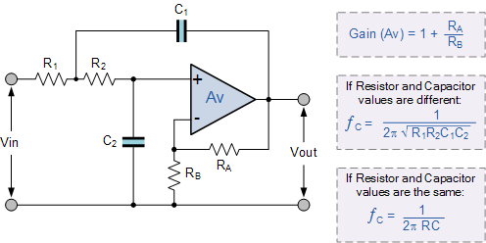
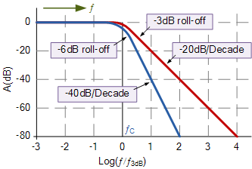
Second Order Low pass Filter
Fig 2. blue line show frequency response of 2nd order low pass filter
Fig 1. circuit diagram

Slide 8
Filter design for 2nd order low pass filter
Choose a value of high cut off Frequency ƒc
2. To simplify the design set R2 = R1 = R and C1= C2= C then choose C less than or equal to 1µF
Calculate R= 1/(2πƒcC)
4. A_{F} = the pass band gain of the filter, (1 + Ra/Rb) = 1.589

Slide 9
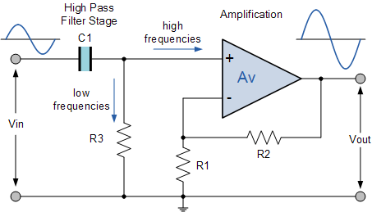
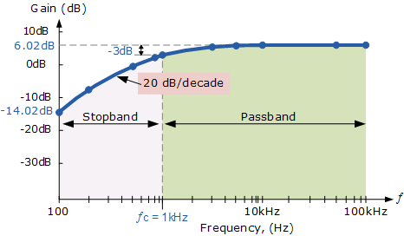
First order HIGH PASS FILTER
Fig circuit diagram
Fig . Frequency response

Slide 10
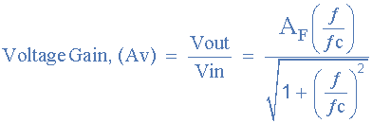
Gain of a first-order Active pass filter
Where:
A_{F} = the pass band gain of the filter, (1 + R2/R1)
ƒ = the frequency of the input signal in Hertz, (Hz)
ƒc = the cut-off frequency in Hertz, (Hz)
Thus, the operation of a low pass active filter can be verified from the frequency gain equation above as:
1. At very low frequencies, ƒ < ƒc
2. At the cut-off frequency, ƒ = ƒc
3. At very high frequencies, ƒ > ƒc

Slide 11
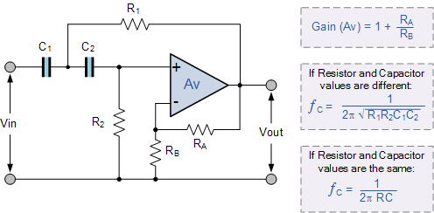
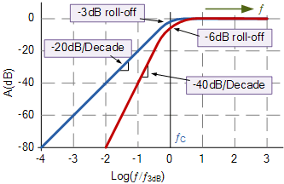
2nd order high pass filter
Fig. circuit diagram
fig 2. Red line show the frequency response of 2nd order

Slide 12
Keep
Learning …
Dr. Mona Bhatnagar

