Slide 1
AECC – Chapter 8 Effective Communication
Barriers
Solutions
Techniques
Alternatives
(Revision)

Slide 2
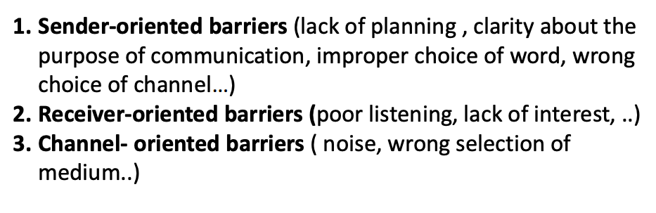
What are barriers to communication:
The ability to communicate – not to be taken for granted
A communication process is a collaborative process where sender and the receiver play a vital role.

Slide 3
Common Barriers to Communication
Semantic Barrier
Language Barrier
Socio-Psychological Barrier
Perceptual Barrier
Emotional Barrier
Interpersonal Barrier
Physical Barrier
Gender Barrier
Organizational Barrier
Sender-Oriented Barrier
Reciever-Oriented Barrier

Slide 4
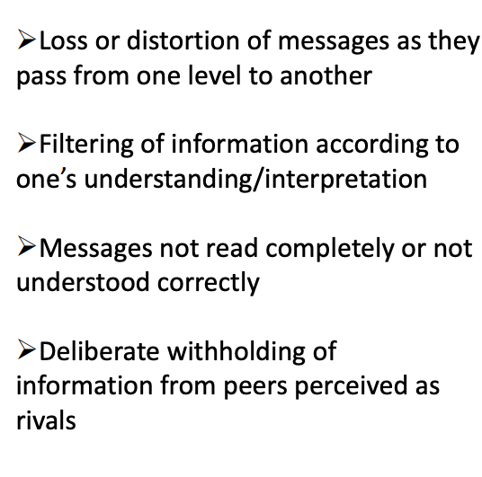
Semantic Barrier – problems that surface due to misinterpretation of transmitted message.
Words – more than one meaning
Jargon
Difference in denotative (actual or literal meaning) and connotative ( abstract nouns and qualities)
Unclarified assumptions
Faulty translation
Language Barrier
expressions, buzz words
Socio-psychological Barriers
Strong emotion; selective perception; poor retention; status and fear inhibits employees
Perceptual Barriers
If each of us saw the world around us in the same way, there would be no need for communication.
Emotional Barriers
Fear, mistrust and suspicion
Interpersonal Barriers
Six levels at which people distance themselves – Withdrawl; Rituals; Pastimes; Working; Games; Closeness
Physical Barriers
Closed office doors, separate cabins, poor outdated equipment; sound; noise
Gender barriers
Organizational Barriers
Chain of command – too long
Sender oriented and receiver oriented barriers

Slide 5
Some strategies for overcoming barriers
Create an atmosphere for openness
Avoid vocal cues
Address people by their names
Let others talk
Do not stereotype
Spend time
Be genuine

Slide 6
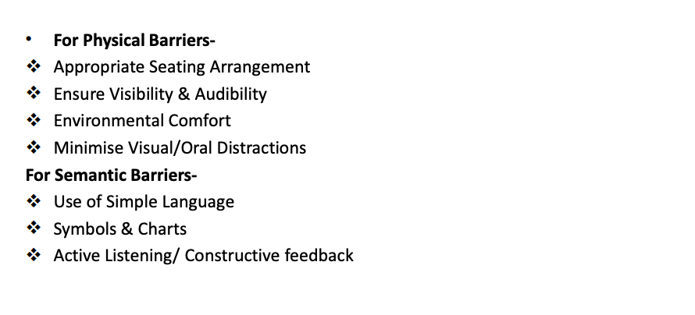
Cont…

Slide 7
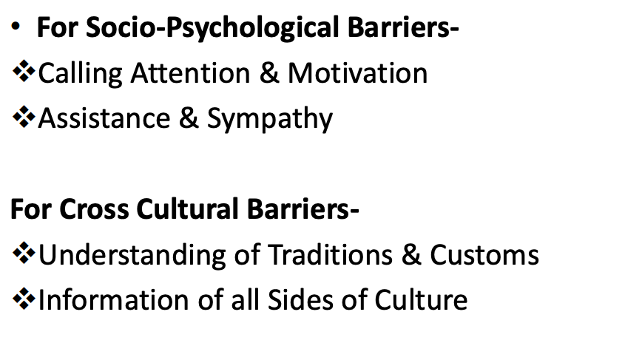
Cont…

Slide 8
