Slide 1
WEEKLY STUDY MATERIAL English (Hons.) II year Paper 8: British Literature: 18th Century Unit 4: Laurence Sterne’s The Life and Opinions of Tristram Shandy, Gentleman Class Representative- Anushka Sahai (94157 17643)

Slide 2
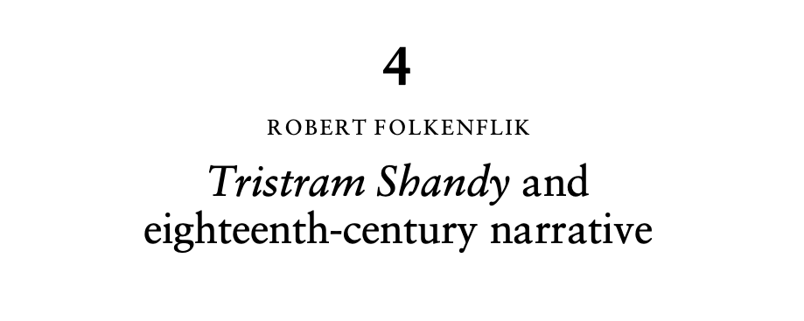
https://duelibrary.informaticsglobal.com:2091/core/services/aop-cambridge-core/content/view/A6F003613E5E36BAF3FDE50B99E52B33/9781139002592c04_p49-63_CBO.pdf/tristram_shandy_and_eighteenthcentury_narrative.pdf

Slide 3
PAGE 50
PAGE 51

Slide 4
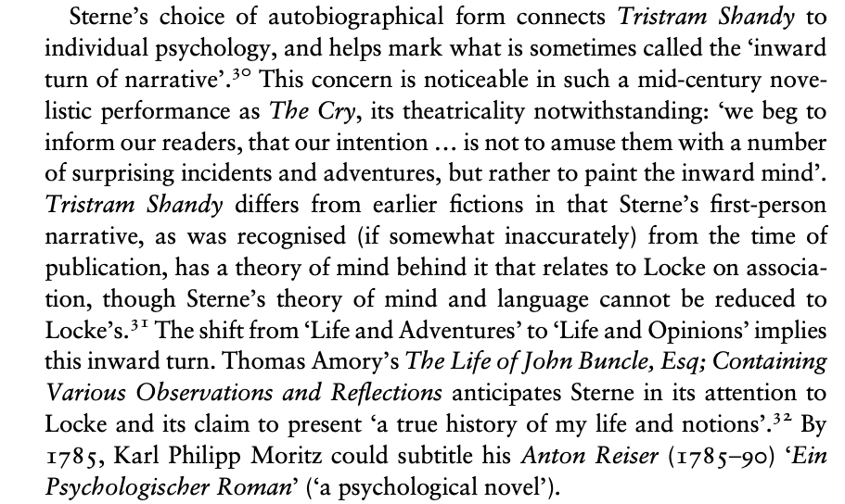
Page 60
STERNE AND THE AUTOBIOGRAPHICAL FORM

Slide 5
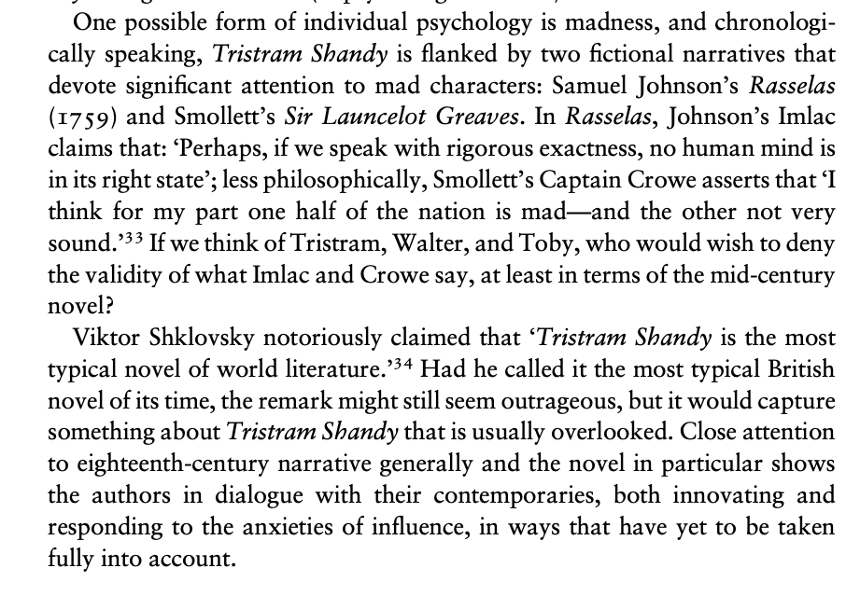
Page 60 cont….

Slide 6
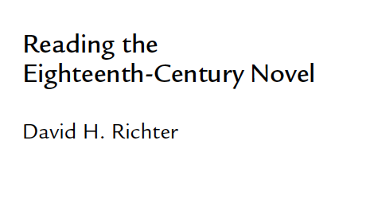

Slide 7
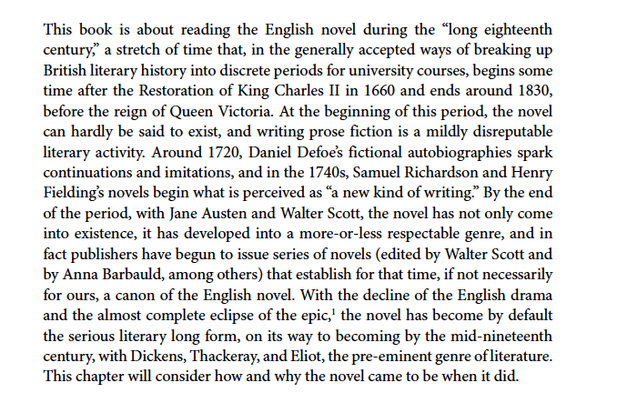

Slide 8
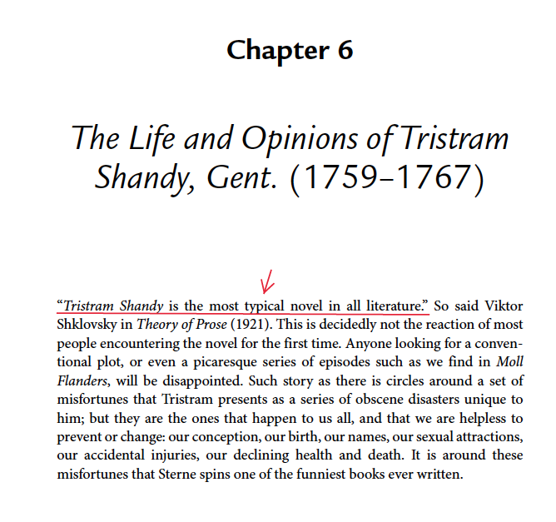

Slide 9
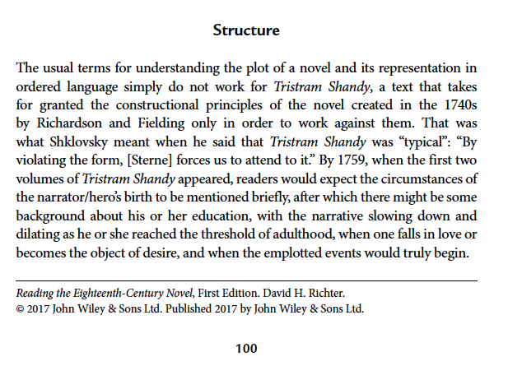

Slide 10
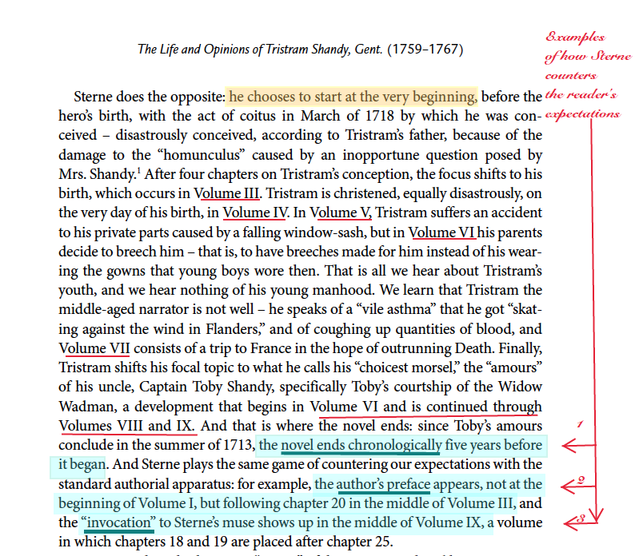

Slide 11
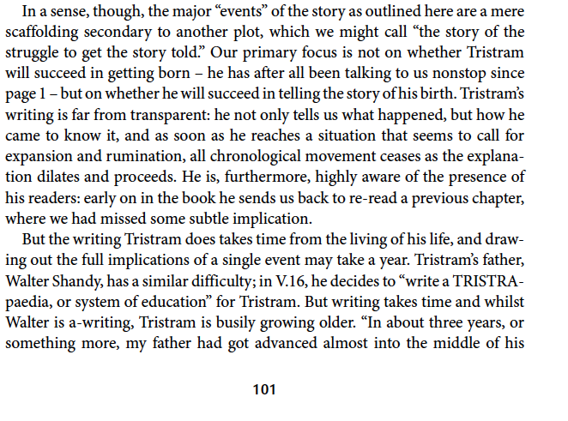

Slide 12
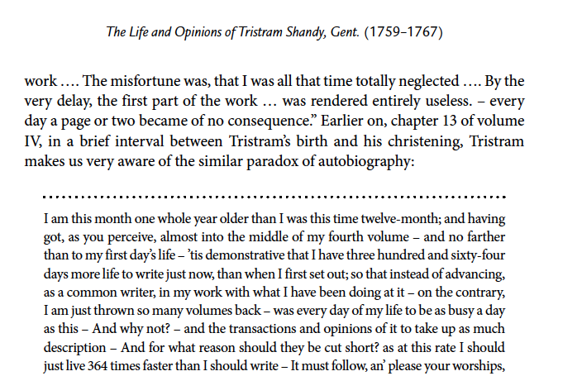

Slide 13
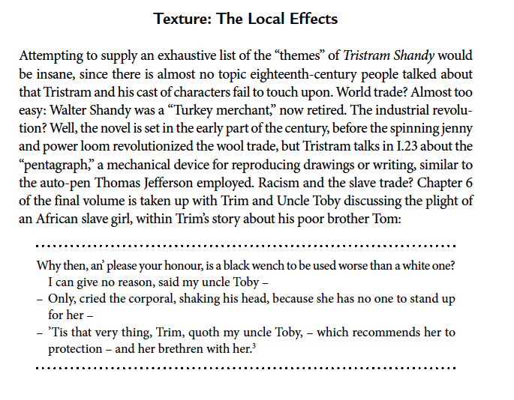

Slide 14
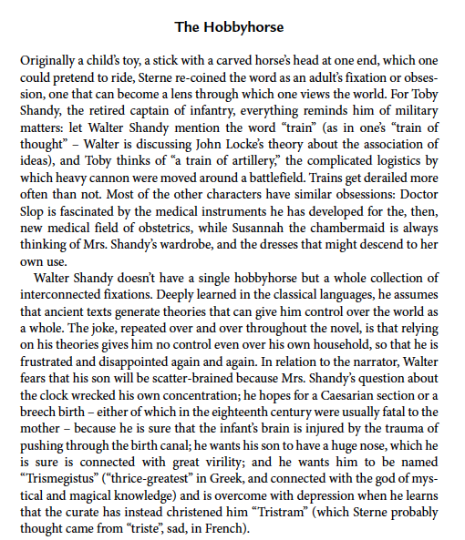

Slide 15
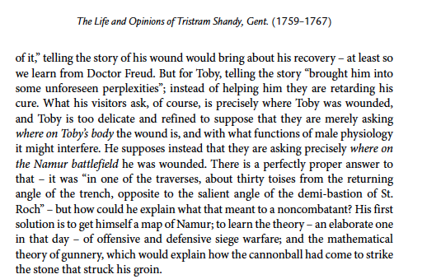

Slide 16
